Slide 1

MGN342-CA2
NAME – Lalit Mohan Prasad
SECTION – Q2565B44
REGISTRATION NO – 12520094

Slide 2
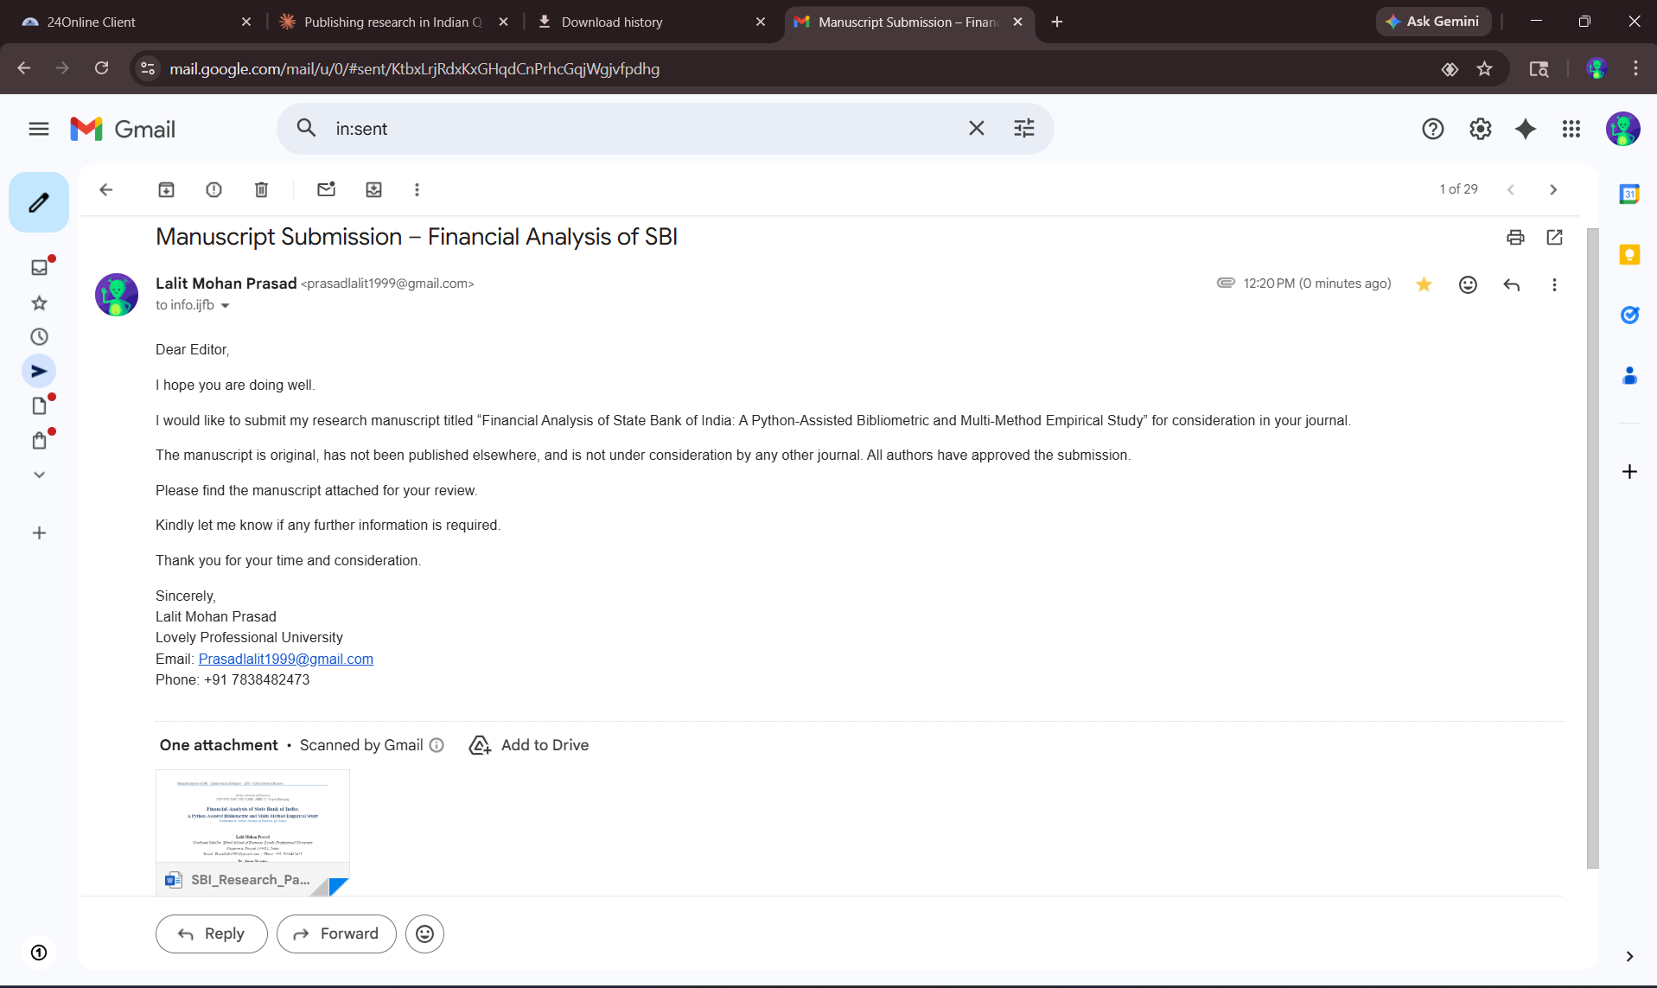
SUBMISSION PROOF

Slide 3
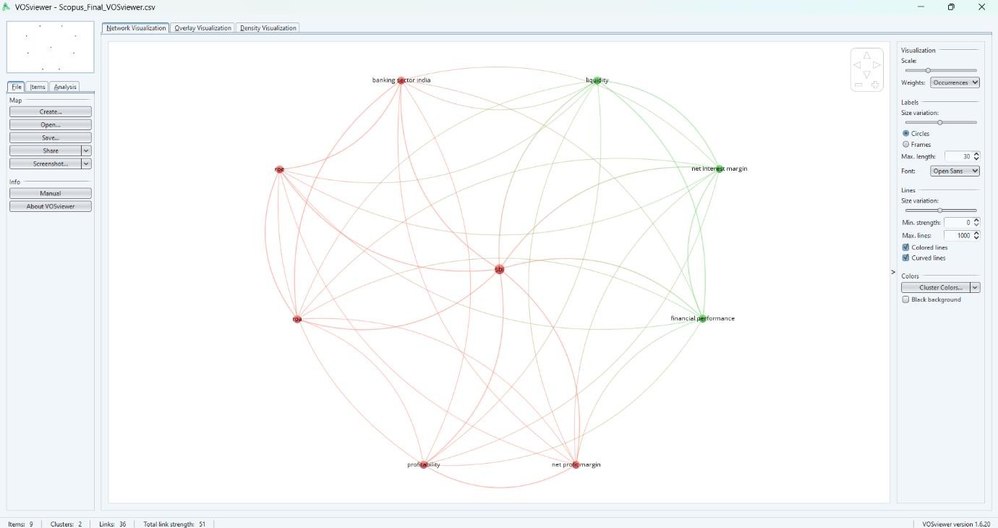
BIBLIOMETRIC IMAGE OF SBI
The analysis revealed strong thematic interconnections within banking research, highlighting the integrated nature of performance evaluation, regulatory frameworks, and risk management in the banking sector

Slide 4
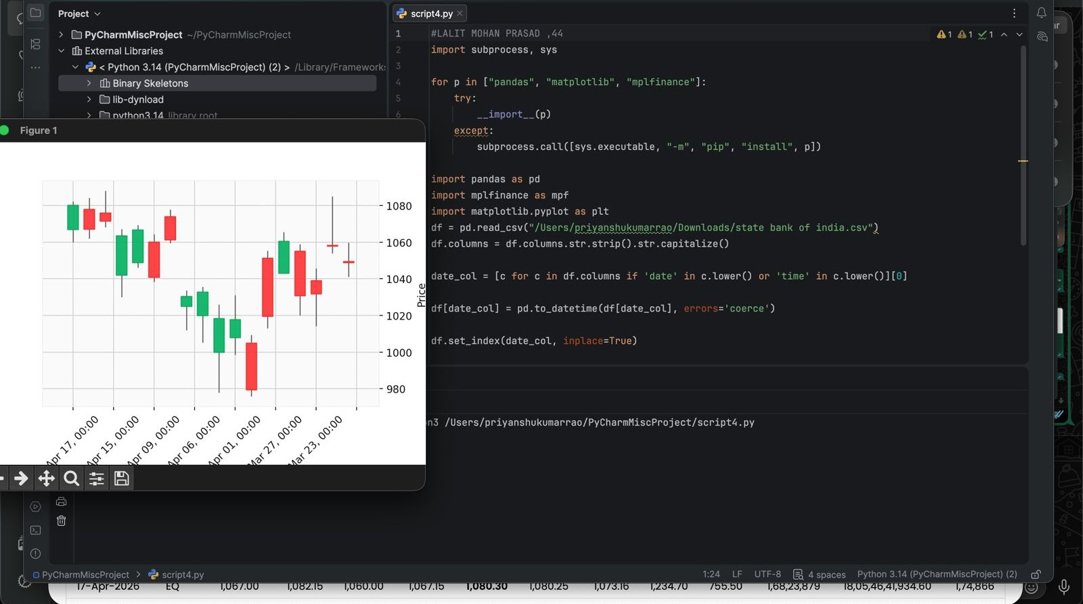
CANDLE STICK

Slide 5
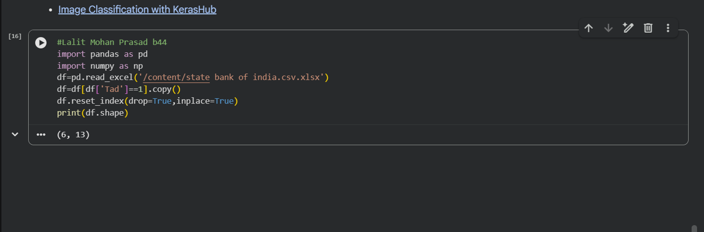
1.How do we remove rows that failed the attention check?
import pandas as pd, numpy as np
df = pd.read_csv(r"C:\Users\LALIT MOHAN PRASAD\Downloads\state bank of india.csv.xlsx")
df = df[df['TAD'] == 1].copy()
df.reset_index(drop=True, inplace=True)
print(df.shape)

Slide 6
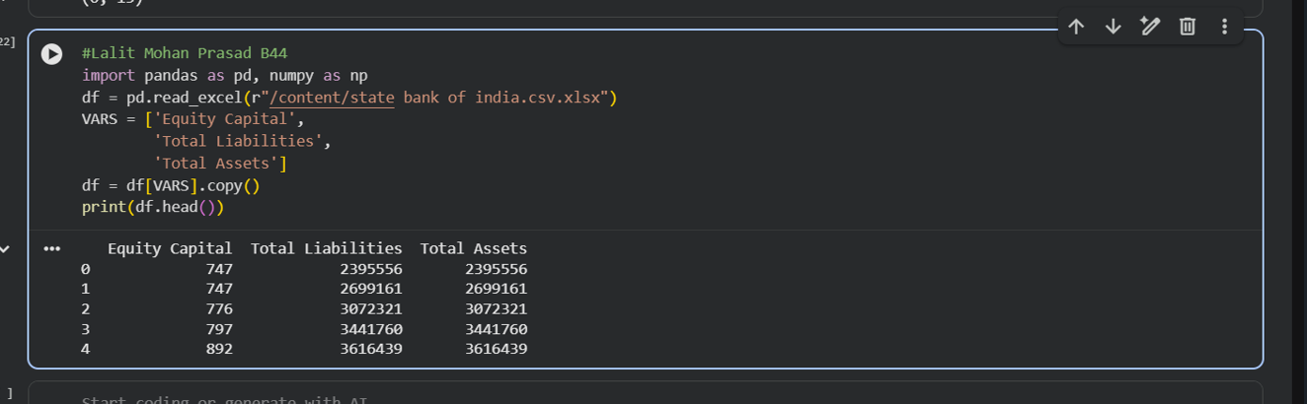
2.How do we select only the variables we need?
import pandas as pd, numpy as np
df = pd.read_csv(r"C:\Users\LALIT MOHAN PRASAD\Downloads\state bank of india.csv.xlsx")
VARS = ['EquityCapital',
'TotalLiabilities',
'TotalAssets']
df = df[VARS].copy()
print(df.head())

Slide 7
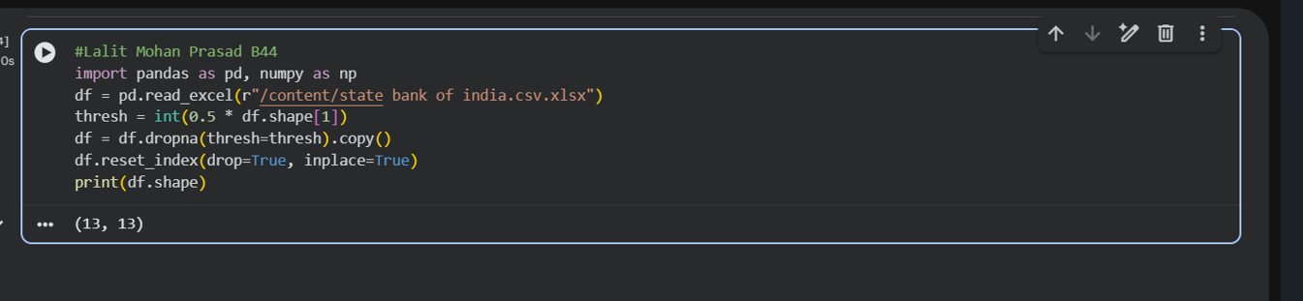
3.How do we delete rows where more than 50% of values are missing?
import pandas as pd, numpy as np
df = pd.read_csv(r"C:\Users\LALIT MOHAN PRASAD\Downloads\state bank of india.csv.xlsx")thresh = int(0.5 * df.shape[1])
df = df.dropna(thresh=thresh).copy()
df.reset_index(drop=True, inplace=True)
print(df.shape)

Slide 8
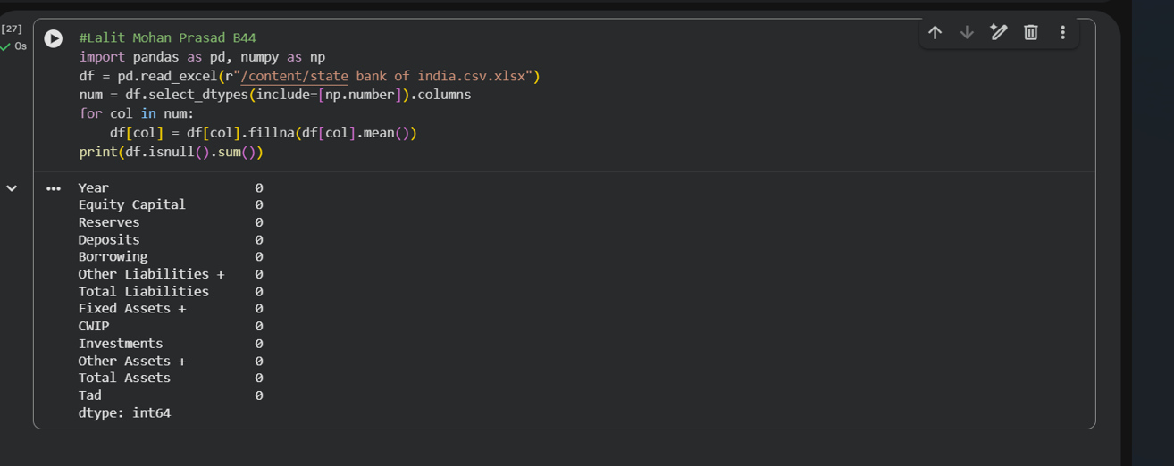
4.How do we fill missing numeric values with the column mean?
import pandas as pd, numpy as np
df = pd.read_csv(r"C:\Users\LALIT MOHAN PRASAD\Downloads\state bank of india.csv.xlsx")num = df.select_dtypes(include=[np.number]).columns
for col in num:
df[col].fillna(df[col].mean(), inplace=True)
print(df.isnull().sum())

Slide 9
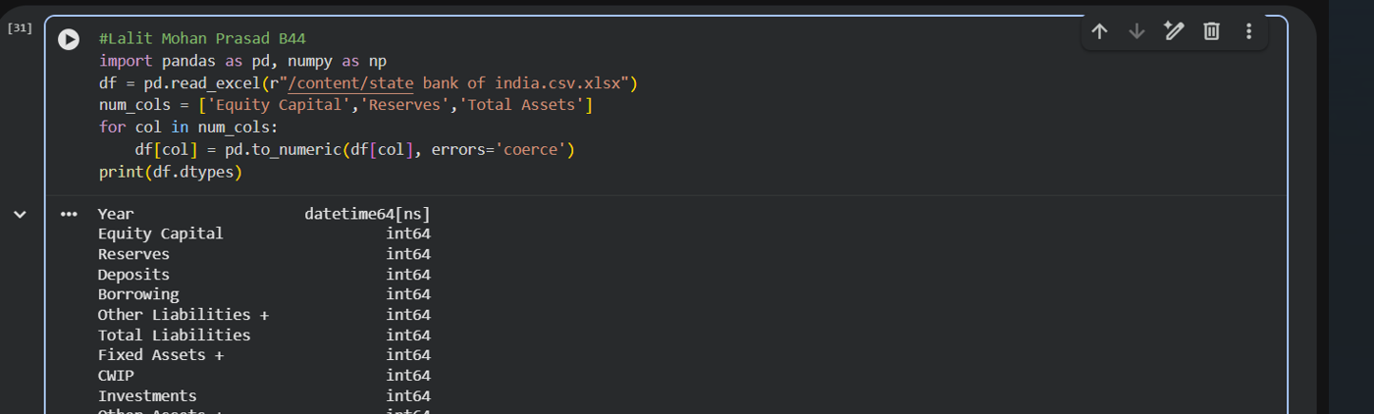
5.How do we ensure all numeric columns have the correct data type?
import pandas as pd, numpy as np
df = pd.read_csv(r"C:\Users\LALIT MOHAN PRASAD\Downloads\state bank of india.csv.xlsx")num_cols = ['EquityCapital','Reserves','TotalAssets']
for col in num_cols:
df[col] = pd.to_numeric(df[col], errors='coerce')
print(df.dtypes)

Slide 10
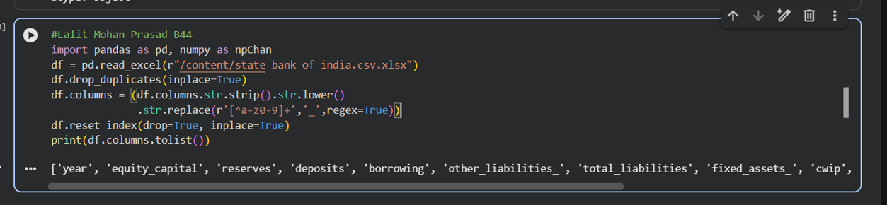
6.How do we remove duplicates and standardise column names?
import pandas as pd, numpy as np
df = pd.read_csv(r"C:\Users\LALIT MOHAN PRASAD\Downloads\state bank of india.csv.xlsx")
df.drop_duplicates(inplace=True)
df.columns = (df.columns.str.strip().str.lower()
.str.replace(r'[^a-z0-9]+','_',regex=True))
df.reset_index(drop=True, inplace=True)
print(df.columns.tolist())

Slide 11
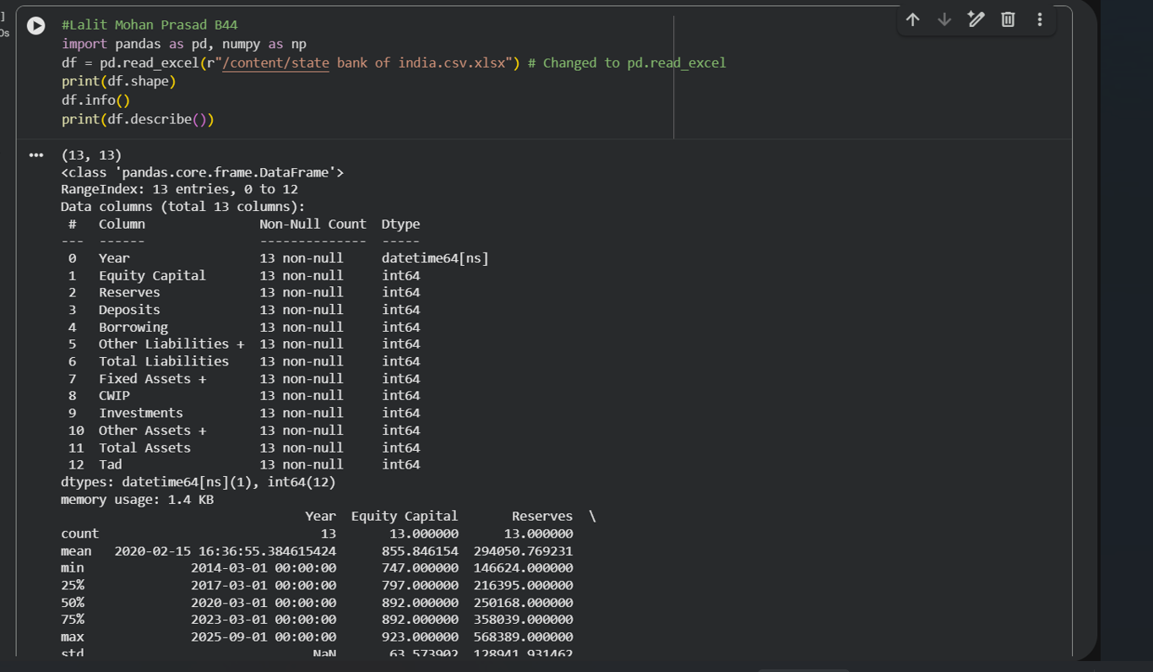
7.How do we get a summary of the dataset's structure?
import pandas as pd, numpy as np
df = pd.read_csv(r"C:\Users\LALIT MOHAN PRASAD\Downloads\state bank of india.csv.xlsx")print(df.shape)
df.info()
print(df.describe())

Slide 12
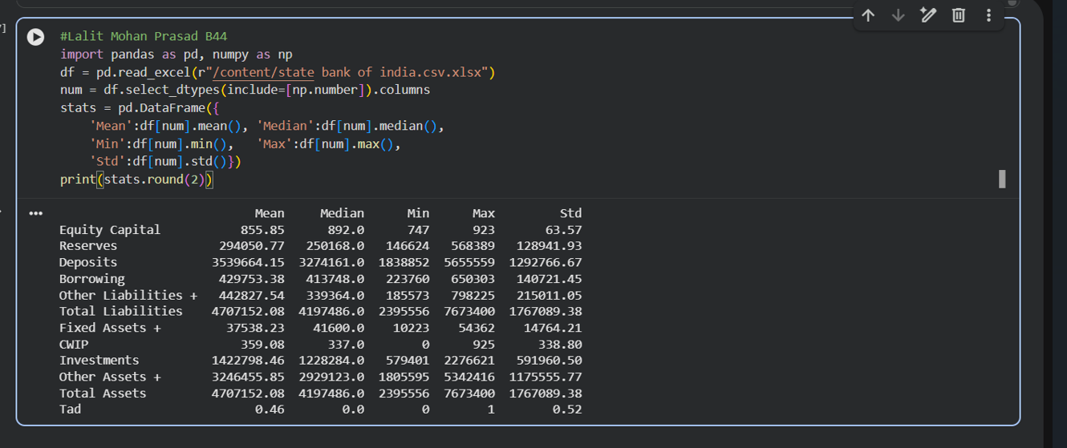
8.How do we compute mean, median, min, max and std deviation?
import pandas as pd, numpy as np
df = pd.read_csv(r"C:\Users\LALIT MOHAN PRASAD\Downloads\state bank of india.csv.xlsx")num = df.select_dtypes(include=[np.number]).columns
stats = pd.DataFrame({
'Mean':df[num].mean(), 'Median':df[num].median(),
'Min':df[num].min(), 'Max':df[num].max(),
'Std':df[num].std()})
print(stats.round(2))

Slide 13
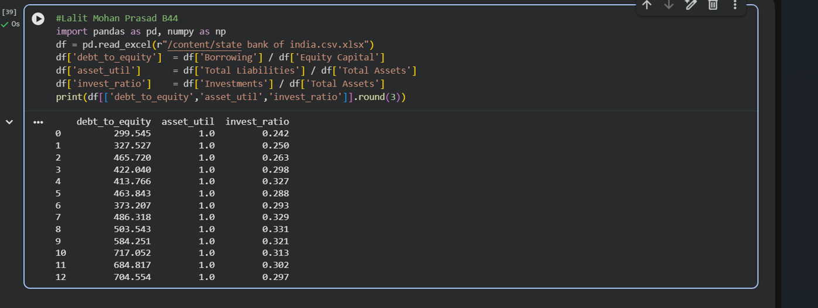
9.How do we create new derived columns from existing ones?
import pandas as pd, numpy as np
df = pd.read_csv(r"C:\Users\LALIT MOHAN PRASAD\Downloads\state bank of india.csv.xlsx")
df['debt_to_equity'] = df['Borrowings +'] / df['EquityCapital']
df['asset_util'] = df['TotalLiabilities'] / df['TotalAssets']
df['invest_ratio'] = df['Investments'] / df['TotalAssets']
print(df[['debt_to_equity','asset_util','invest_ratio']].round(3))

Slide 14
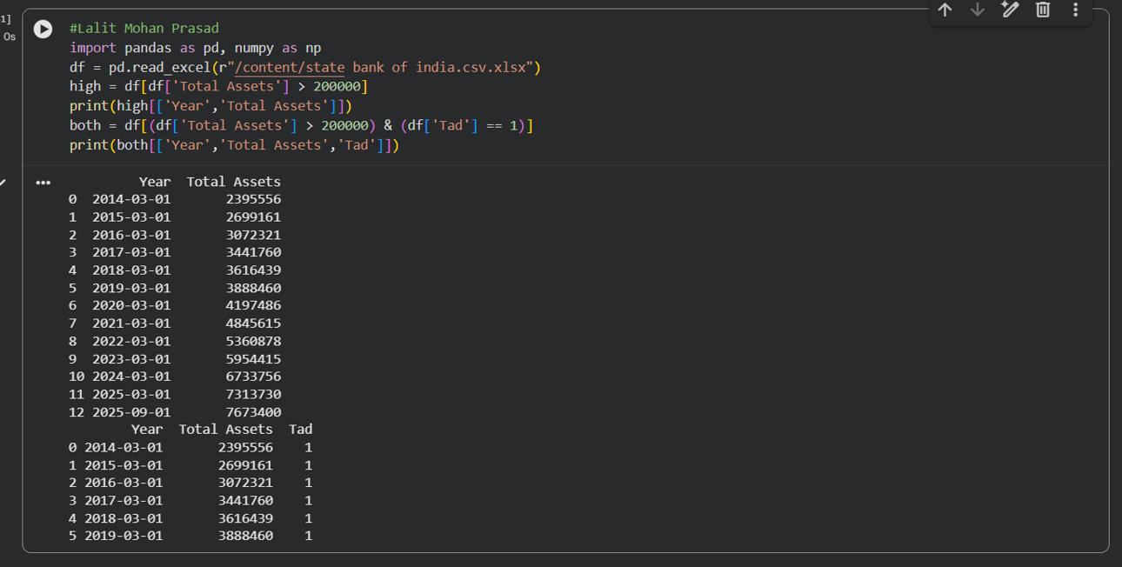
10.How do we filter rows based on a condition?
import pandas as pd, numpy as np
df = pd.read_csv(r"C:\Users\LALIT MOHAN PRASAD\Downloads\state bank of india.csv.xlsx")
high = df[df['TotalAssets'] > 200000]
print(high[['Year','TotalAssets']])
both = df[(df['TotalAssets'] > 200000) & (df['TAD'] == 1)]
print(both[['Year','TotalAssets','TAD']])

Slide 15
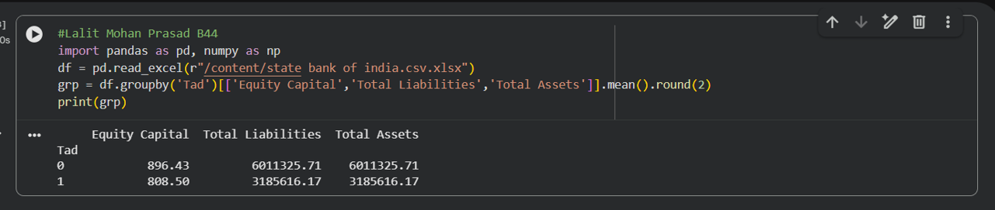
11.How do we compute group-wise statistics using groupby?
import pandas as pd, numpy as np
df = pd.read_csv(r"C:\Users\LALIT MOHAN PRASAD\Downloads\state bank of india.csv.xlsx")
grp = df.groupby('TAD')[['EquityCapital','TotalLiabilities','TotalAssets']].mean().round(2)
print(grp)

Slide 16
summary
The project focused on analyzing State Bank of India (SBI) data using Python tools.
• Data cleaning steps included:
• Removing invalid rows (attention check)
• Handling missing values
• Removing duplicates and fixing column names
• Important data preparation techniques were applied such as:
• Selecting relevant variables
• Converting data types
• Filtering and structuring datasets
• Statistical analysis was performed using:
• Mean, median, min, max, and standard deviation
• Group-wise analysis using groupby
• New insights were generated by creating derived financial ratios (e.g., debt-to-equity, asset utilization).
• The study highlights how Python helps in efficient data processing, analysis, and decision-making in banking research

